Slide 1


Big Data Seminar – BIA 678
Class 6 – Data Management II
David Belanger PhD
Senior Research Fellow – Stevens Institute of Technology
dbelange@stevens.edu

Slide 2
Class 6 Outline
Administrative Stuff:
Formation of teams Complete
Term Paper Info
Make-up Class
Next couple of weeks
Guest speaker: Dr. Yifan Hu, (Oath/Verizon, nee Yahoo), Visualization, April 28th.
Activity #1 – Finish Data Management
Activity #2A/B – Readings
Stonebreaker – One Size Fits None
One of:
Introduction to Cassandra, https://academy.datastax.com/resources/brief-introduction-apache-cassandra
Introduction to MongoDB, https://docs.mongodb.com/manual/introduction/
Assignment #1
Data Stream Mining, A Survey Gupta, Rajput, http:citeseerx.ist.psu.edu/viewdoc/download?doi=10.1.1.415.1674&rep=rep1&type=pdf

Slide 3
Schedule for Remainder of Semester
There is a make-up class to be fit in sometime (TBD + Possible Additional Speaker – T. Au).
March 12 – DataBase Management
March 26 – Data Stream Management + Data Stream Analysis
April 2 – Finish Data Stream Analysis + Analytics (Recommenders)
April 9 – Recommender Systems
April 16 – Ensembles – Boosting (Adaboost, XGBoost)
April 23 – Governance++
April 30 – Visualization (Hu), Team Projects, Selected Topics.
May 7 – Team Reports – Oral
May 10 – Team Reports - Written

Slide 4
Term paper Discussion

Slide 5
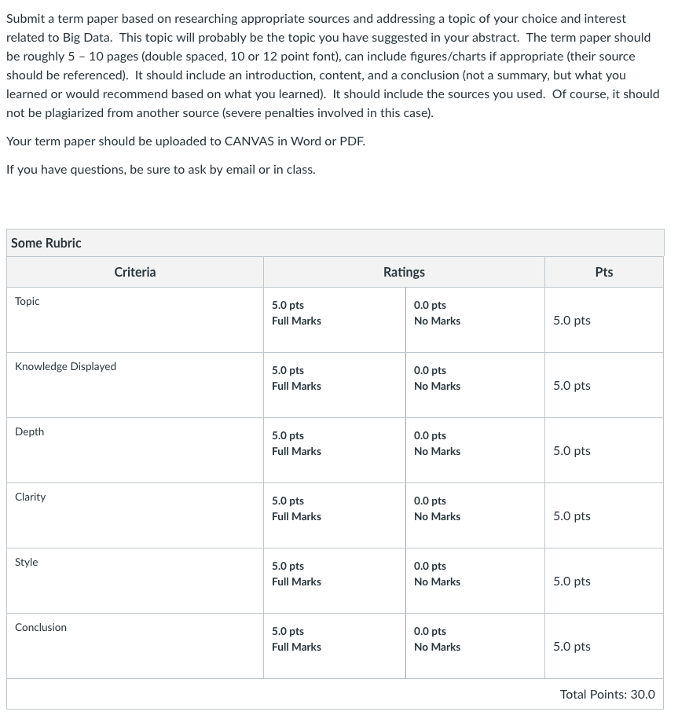

Slide 6
MPP Data Architectures
Sharded MPP
Multiple DBs unified at Application layer
Web Apps: eCommerce, Social
Federated MPP
Multiple DBs unified at Federation layer
DW / Analytics
True MPP
Single DB with distributed storage and SQL execution
DW / Analytics
Client
Client
Client
Client
Client
Client
Application Layer
DB Federation Layer
Overhead eliminated
Meta-data Mgr
SQL Engine
Natively-parallel SQL Engine
Storage Mgr
Scale by adding full instances of DB. Integration across shards done outside DBs.
Custom-built
Scale by adding full instances of DB, one per CPU core. Integration across shards done outside DBs.
Redshift, Azure SQL DW
Scale by adding nodes of multi-threaded execution engines. Integration across nodes done inside engine.
Teradata, XtremeData

Slide 7
NoSQL
By Perry Hoekstra
Technical Consultant
Perficient, Inc.
perry.hoekstra@perficient.com

Slide 8
What is NoSQL?
Stands for Not Only SQL
Class of non-relational data storage systems
Usually do not require a fixed table schema nor do they use the concept of joins
All NoSQL offerings relax one or more of the ACID properties (will talk about the CAP theorem)
Notes:
-> NoSQL was a term coined by Eric Evans. He states that ‘… but the whole point of seeking alternatives is that you need to solve a problem that relational databases are a bad fit for. …
-> This is why people are continually interpreting nosql to be anti-RDBMS, it's the only rational conclusion when the only thing some of these projects share in common is that they are not relational databases.’
-> Emil Elfrem stated it is not a ‘NO’ SQL but more of a ‘Not Only” SQL.

Slide 9
Why NoSQL?
For data storage, an RDBMS cannot be the be-all/end-all
Just as there are different programming languages, need to have other data storage tools in the toolbox
A NoSQL solution is more acceptable to a client now than even a year ago
Notes:
-> Too often as consultants, when we talk about data storage, we immediately reach for a relational database.
-> Relational databases offer a very good general purpose solution to many different data storage needs.
-> In other words, it is the safe choice and will work in many situations.
-> Need to have some knowledge of alternatives, if nothing else to know when a NoSQL solution needs further investigation.

Slide 10
How did we get here?
Explosion of social media sites (Facebook, Twitter) with large data needs
High volume data streams leading to append only data base management systems
Rise of cloud-based solutions such as Amazon S3 (simple storage solution)
Just as moving to dynamically-typed languages (e.g. Ruby), a shift to dynamically-typed data with frequent schema changes
Open-source community
Notes:
-> However, the people with the largest datasets (terrabyte/petabyte) began to realize that sharding was putting a bandage on their issues. The more aggressive thought leaders (Google, Facebook, Twitter) began to explore alternative ways to store data. This became especially true in 2008/2009.
-> These datasets have high read/write rates.
-> With the advent of Amazon S3, a large respected vendor made the statement that maybe is was okay to look at alternative storage solutions other that relational.
-> All of the NoSQL options with the exception of Amazon S3 (Amazon Dynamo) are open-source solutions. This provides a low-cost entry point to ‘kick the tires’.

Slide 11
NoSQL – Key-Value Data Model (1)
Data is represented as a collection of key–value pairs.
key–value model is one of the simplest non-trivial data models
richer data models are implemented on top of it.
Also known as: key-value pairs, associative arrays, dictionaries, maps
1825 Stacy Johnson
key (index)
value

Slide 12
NoSQL – Key-Value Data Model (2)
In computer science, an associative array, map, symbol table, or dictionary is an abstract data type composed of a collection of (key, value) pairs, such that each possible key appears just once in the collection
Challenges:
efficiently insert a (key, value) pair in the collection
efficiently search for a (key, value) in the collection
in general, management of the (key, value) pairs in the collection

Slide 13
NoSQL – Key-Value Data Model (3)
Most data models can be decomposed to a collection of key-value pairs. The most basic data model.
dept: 34
name: Nick
name: Marketing
Employee 1524
Dept 34
(E_name_1524, Nick)
(E_age_1524, 24)
(E_gender, male)
(E_dept, 34)
(D_name_34, Marketing)
age: 24
gender: male

Slide 14
NoSQL – Key-Value Model Applications
Relational model is not suitable for all applications
schemaless applications
e.g. html
integration of several data sources
use a common repository that several processes populate
high throughput
access very fast data items
Interactive Visualization at Scale

Slide 15
NoSQL – Key-value Stores
Representative systems:
Memcached (memory-based)
Project Voldemort
Riak
Redis
Scalaris
Tokyo Cabinet

Slide 16
2005-2010: NoSQL, Document stores

Slide 17
NoSQL – Semi-structured Data Model
A text document that:
contains data [content]
contains metadata (descriptions about the data) [semantics]
describes structure of the data [structure]
Examples: XML, JSON, BSON
A self-documented data model
e.g. in relational model structure is implied: data are arranged in rows, all rows form a table, no nesting is allowed

Slide 18
NoSQL – Document Stores (1)
Document Stores: These systems store documents, as just defined (structure, nested, flexible schema). The documents are indexed and a simple query mechanism is provided.
Representative systems:
SimpleDB
Couchbase (formerly CouchDB)
MongoDB
Terrastore

Slide 19
NoSQL – Document Stores (2)
In key-value stores, values may be objects but do not have structure
In document stores, values are documents, i.e. they have structure that can be used by the system (e.g. build secondary indexes on components of the documents)
Multiple types of documents
Nested documents

Slide 20
Document Stores – MongoDB, General (1)
Written in C++
MongoDB uses collections for storing groups of data. A collection can be thought as a table in a relational DB.
Collections hold documents.
Tables ⬅➔ Collections
Rows ⬅➔ Documents
Not all documents in a collection have same schema. Maximum size is 16MB

Slide 21
Document Stores – MongoDB, General (2)
Documents: JSON, XML, Python Dictionary, Ruby hash
Stored internally as BSON (Binary JSON)
{
title : " MongoDB ",
last_editor : "172.5.123.91" ,
last_modified : new Date ("9/23/2010"),
body : " MongoDB is a document store",
categories : [" Database ", " NoSQL ", " Document Database "],
reviewed : false
}

Slide 22
2005-2010: NoSQL, Graph databases

Slide 23
NoSQL – Graph DBs
Graph Databases: This kind of database is designed for data whose relations are well represented as a graph (elements interconnected with an number of relations between them)
Representative systems:
FlockDB
Neo4j
OrientDB

Slide 24
NoSQL – Graph DBs, General
Graph databases:
Nodes
Relationships (edges)
Properties on nodes and relationships
Traversal methods on graphs: BFS, DFS, A*
RDF (Resource Description Format – see Semantic Web)
Applications:
Social networks, retail, telcos, etc…
Reference:
Graph Databases by Ian Robinson, Jim Webber & Emil Eifrem, O’Reilly
http://cray.com/sites/default/files/resources/Bloor-Graph-Analytics-Report.pdf

Slide 25
NoSQL – Graph DBs, What is a Graph?
Node
ID, type, attributes
Edge
connects two nodes
Direction, type, attributes
Query
Navigating (traversing) the graph

Slide 26
NoSQL – Graph DBs, Motivating Apps (1)
Social graphs:
Social networks help us identify the direct and indirect relationships between people, groups, and the things with which they interact, allowing users to rate, review, and discover each other and the things they care about
Geospatial:
Geospatial applications of graph databases range from calculating routes between locations in an abstract network such as a road or rail network, airspace network, or logistical network to spatial operations such as find all points of interest in a bounded area or find the center of a region

Slide 27
NoSQL – Graph DBs, Motivating Apps (2)
Recommendation:
Recommendation algorithms establish relationships between people and things: other people, products, services, media content—whatever is relevant to the domain in which the recommendation is employed. Relationships are established based on users’ behaviors, whether purchasing, producing, consuming, rating, or reviewing the resources in question
Network Management:
the physical and virtual assets inside a data center can be easily modeled with a graph. Communications networks are graph structures; graph databases are, therefore, a great fit for modeling, storing, and querying this kind of domain data

Slide 28
Source: BIG – Section 5 - (Buerli 2012)

Slide 29
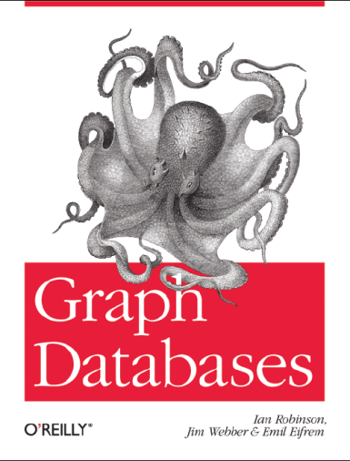

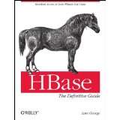
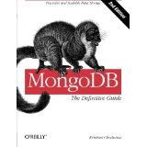

NoSQL Databases
Voldemort

Slide 30
Dynamo and BigTable
Three major papers were the seeds of the NoSQL movement
BigTable (Google)
Dynamo (Amazon)
Gossip protocol (discovery and error detection)
Distributed key-value data store
Eventual consistency
CAP Theorem
Notes:
-> BigTable: http://labs.google.com/papers/bigtable.html
-> Dynamo: http://www.allthingsdistributed.com/2007/10/amazons_dynamo.html and http://www.allthingsdistributed.com/files/amazon-dynamo-sosp2007.pdf
-> Amazon and consistency
* http://www.allthingsdistributed.com/2010/02
* http://www.allthingsdistributed.com/2008/12

Slide 31
NoSQL, Dynamo and BigTable
Examples:
Hbase is a clone of Google BigTable
Cassandra was built by Facebook and merges concepts from Amazon Dynamo and Google BigTable
MongoDB is an attempt to keep as much of the benefits of the relational model as possible, while adjusting to scale.
Notes:
-> BigTable: http://labs.google.com/papers/bigtable.html
-> Dynamo: http://www.allthingsdistributed.com/2007/10/amazons_dynamo.html and http://www.allthingsdistributed.com/files/amazon-dynamo-sosp2007.pdf
-> Amazon and consistency
* http://www.allthingsdistributed.com/2010/02
* http://www.allthingsdistributed.com/2008/12

Slide 32
The Perfect Storm
Large datasets, acceptance of alternatives, and dynamically-typed data has come together in a perfect storm
Not a backlash/rebellion against RDBMS
SQL is a rich query language that cannot be rivaled by the current list of NoSQL offerings. It is also a relatively simpler data model than many of the NoSQL models.
Notes:
-> So you have reached a point where a read-only cache and write-based RDBMS isn’t delivering the throughput necessary to support a particular application.
-> You need to examine alternatives and what alternatives are out there.
-> The NoSQL databases are a pragmatic response to growing scale of databases and the falling prices of commodity hardware.
-> Most likely, 10 years from now, the majority of data is still stored in RDBMS.

Slide 33
What kinds of NoSQL
NoSQL solutions fall into two major areas:
Key/Value or ‘the big hash table’.
Amazon S3 (Dynamo)
Voldemort
Scalaris
Schema-less which comes in multiple flavors, column-based, document-based or graph-based.
Cassandra (column-based)
CouchDB (document-based)
Neo4J (graph-based)
HBase (column-based)
Notes:
-> Not an exhaustive list, just some of the more well-known.
-> HBase is the data storage solution for Hadoop.
-> Graph: is a network database that uses edges and nodes to represent and store data.
-> Document: views are stored as rows which are kept sorted by key. Can adapt to variations in document structure.

Slide 34
Key/Value
Pros:
very fast
very scalable
simple model
able to distribute horizontally
Cons:
- many data structures (objects) can't be easily modeled as key value pairs
Notes:
-> http://chariotsolutions.blogspot.com/2010/01/why-you-need-nosql-in-your-toolbox.html

Slide 35
Schema-Less
Pros:
- Schema-less data model is richer than key/value pairs
eventual consistency
many are distributed
still provide excellent performance and scalability
Cons:
- typically no ACID transactions or joins

Slide 36
Common Advantages
Cheap, easy to implement (open source)
Data are replicated to multiple nodes (therefore identical and fault-tolerant) and can be partitioned
Down nodes easily replaced
No single point of failure
Easy to distribute
Don't require a schema
Can scale up and down
Relax the data consistency requirement (CAP)
Notes:
-> As the data is written, the latest version is on at least one node. The data is then versioned/replicated to other nodes within the system.
-> Eventually, the same version is on all nodes.

Slide 37
What am I giving up?
joins
group by
order by
ACID transactions
SQL as a sometimes frustrating but still powerful query language
easy integration with other applications that support SQL
Notes:
-> No JDBC
-> Data integrity at the application layer

Slide 38
HBase
2014-09-19

Slide 39
HBase Agenda
Hadoop Ecosystem
HBase is / is NOT
Examples
HBase main features
HBase vs other systems

Slide 40
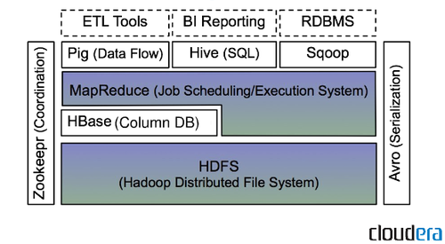
Hadoop Ecosystem

Slide 41
HBase is
Open-source Apache project
Column-oriented model for big sparse table
Modeled after Google's Big table
Non-relational, distributed, large database
Consistent and partition tolerant
Notes:
3. “A distributed Storage System for Structured Data”
4. very large tables with billions of rows, X millions of columns.

Slide 42
HBase is NOT
Not a SQL speaker
Not an RDBMS or HDFS replacement
No JOIN across records
Not suited for small datasets
Not suited for low-latency data access
No full support for ACID
(Atomicity, Consistency, Isolation, and Durability)
http://hadoop-hbase.blogspot.com/2012/03/acid-in-hbase.html
Notes:
Comparing to RDBMS, HBase have better write performance, but worse read performance.
This is because HBase index use the LSM(Log-Structured-Merge) Tree, which have data strictly sorted in a small tree(locally), but not in the whole tree.

Slide 43
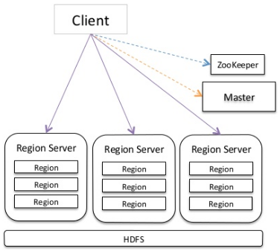
HBase: Master, Region, RegionServer
HBase Master
Coordinates the HBase Cluster:
Assignment/Balancing of the Regions
Handles Admin operations: create/delete/modify table, …
Region
Contiguous, sorted range of rows stored together
Basic unit of scalability in HBase
Subset of table’s data
RegionServer
Contains a set of Regions
Handle read and writes
Notes:
ZooKeeper
1. Distributed, available, reliable coordination system
2. http://research.google.com/archive/chubby.html

Slide 44
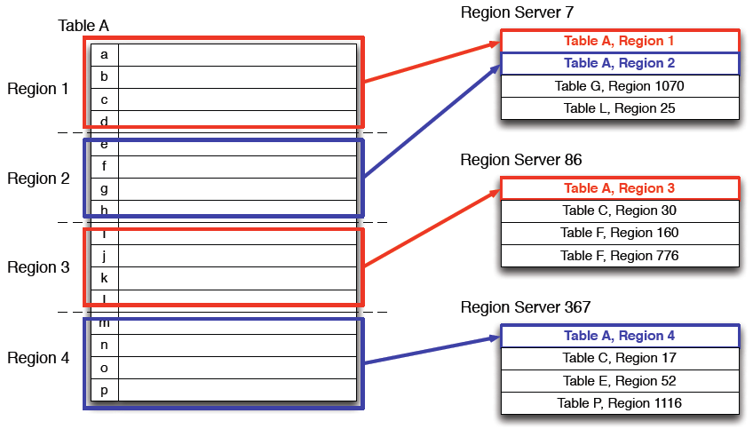
Logical Architecture

Slide 45
Column Families
HBase tables have a “Key: (Column/Value)” structure
Dynamic columns(qualifiers), no schema needed
“Fixed” column groups(column families)
table[row:column_family:column] = value
Tables ‘student_info’ are broken into groupings called ‘Column Families’.
HBASE_ROW_KEY | Contact |  | Name
Student_ID | cell | email | first | last
Group data frequently accessed together and compressed

Slide 46
Rows and Columns
Each column has a timestamp
No storage penalty for unused columns
RowKey | Contact |  | Name
0001 | cell:201-***-**** timestamp: 1412052327489 |  | first: Jone timestamp: 1412052323268 | last:Doe timestamp: 1412052328374
0003 | cell:202-***-**** timestamp: 1413039528742 | email:a@b.com timestamp: 1413039563331 | first: Jane timestamp: 1412052325091 | last:Doe timestamp: 1412052329219
0006 |  |  | first:Andre timestamp: 1412052328887 | last:Dupont timestamp: 1412052328882
Row keys to identify a row
Each Column Family can have many columns

Slide 47
Map Table to Regions
Region 1
Region Server 1
RowKey | Contact |  | Name
0001 | … |  | first:Jone | last:Doe
0003 | … | … | first:jane | last:Doe
Table | Region
student_info | 1
table_x | 1000
Region 2
Region Server 7
RowKey | Contact |  | Name
0005 |  |  | first: Andre | last:Dupont
0009 | …… | … | first:Alica | last:Keys
Table | Region
student_info | 2
table_y | m
table_z | n
Table ‘student_info’ is broken into regions

Slide 48
HBase Main Features
Horizontal scalability
Increase capacity by adding data node
Improve I/O by adding region server
Row-level atomic operations including compare-and-swap ops like incrementing counters
Augmented key-value schemas, the user can group columns into families which are configured independently

Slide 49
HBase Main Features Cont.
Low latency random read / write to HDFS
Runs on top of HDFS
Runs on commodity hardware

Slide 50
HBase vs HDFS alone
 | Plain HDFS /MapReduce | HBase
Write pattern | Append-only | Random write, bulk incremental
Read pattern | Full table scan, partition table scan | Random read, small range scan, or table scan
Hive(SQL) performance | Very good | 4-5x slower
Structured storage | Do-it-yourself / TSV / Sequencial File | Sparse column-family data model
Max data size | 30+ PB | ~1PB
From: Chicago Data Summit: Apache HBase: An Introduction

Slide 51
HBase vs RDBMS
 | RDBMS | HBase
Data layout | Row-oriented | Column-family oriented
Transactions | Multi-row ACID | Single row only
Query language | SQL | get/put/scan/
security | Authentication / authorization | Work in progress
Indexes | On arbitrary columns | Row-key only
Max data size | TBs | ~1PB
Read/write throughput limits | 1000s queries/second | Millions of queries/second
From: Chicago Data Summit: Apache HBase: An Introduction

Slide 52
HBase API
get(row)
Gets a row’s data based on the row key
put(row, Map<column, value>)
Update/inserts a row with data based on the row key
scan(key range, filter)
Finds all matching rows based on the row key
Scan logic can be increased by using filters
Increment(row, columns)
MapReduce/Hive
…

Slide 53
Cassandra
Originally developed at Facebook
Follows the BigTable data model: column-oriented
Uses the Dynamo Eventual Consistency model
Written in Java
Open-sourced and exists within the Apache family
Uses Apache Thrift as it’s API

Slide 54
Thrift
Created at Facebook along with Cassandra
Is a cross-language, service-generation framework
Binary Protocol (like Google Protocol Buffers)
Compiles to: C++, Java, PHP, Ruby, Erlang, Perl, ...
Notes:
-> http://incubator.apache.org/thrift/static/thrift-20070401.pdf
-> http://incubator.apache.org/thrift/
-> Thrift also created by Facebook engineers and donated to Apache

Slide 55
Apache Database Overview
Apache HBaseUse Apache HBase software when you need random, realtime read/write access to your Big Data. This project's goal is the hosting of very large tables -- billions of rows X millions of columns -- atop clusters of commodity hardware. HBase is an open-source, distributed, versioned, column-oriented store modeled after Google's Bigtable: A Distributed Storage System for Structured Data by Chang et al. Just as Bigtable leverages the distributed data storage provided by the Google File System, HBase provides Bigtable-like capabilities on top of Hadoop and HDFS
Apache Cassandra Linear scalability and proven fault-tolerance on commodity hardware or cloud infrastructure make Apache Cassandra the perfect platform for mission-critical data. Cassandra's support for replicating across multiple datacenters is best-in-class. Cassandra is in use at Netflix, Twitter, Urban Airship, Constant Contact, Reddit, Cisco, OpenX, Digg, CloudKick, Ooyala, and more companies that have large, active data sets. Cassandra provides full Hadoop integration, including with Pig and Hive.

Slide 56
Cassandra Overview
Use an RDBMS when you need/have... | Use NoSQL when you need/have...
Centralized applications (e.g. ERP) | Decentralized applications (e.g. Web, mobile and IOT)
Moderate to high availability | Continuous availability; no downtime
Moderate velocity data | High velocity data (devices, sensors, etc.)
Data coming in from one/few locations | Data coming in from many locations
Primarily structured data | Structured, with semi/unstructured
Complex/nested transactions | Simple transactions
Primary concern is scaling reads | Concern is to scale both writes and reads
Philosophy of scaling up for more users/data | Philosophy of scaling out for more users/data
To maintain moderate data volumes with purge | To maintain high data volumes; retain forever

Slide 57
Cassandra Query CQL Select
SELECT
Syntax:
<selectStatement> ::= "SELECT" <whatToSelect>
"FROM" ( <name> "." )? <name>
( "USING" "CONSISTENCY" <consistencylevel> )?
( "WHERE" <selectWhereClause> )?
( "LIMIT" <integer> )?
;
<whatToSelect> ::= <term> ( "," <term> )*
| ("FIRST" <integer> )? "REVERSED"? <columnRange>
| "COUNT" "(" <countTarget> ")"
;
<columnRange> ::= <term> ".." <term>
| "*"
;
<countTarget> ::= "*"
| "1"
;
<name> ::= <identifier>
| <stringLiteral>
| <integer>
;
<selectWhereClause> ::= <relation> ( "AND" <relation> )*
| <term> "IN" "(" <term> ( "," <term> )* ")"
;
<relation> ::= <term> <relationOperator> <term>
;
<relationOperator> ::= "=" | "<" | ">" | "<=" | ">="
;

Slide 58
Cassandra Overview
Sample:
SELECT Name, Occupation FROM People WHERE key IN (199, 200, 207);
SELECT FIRST 3 REVERSED 'time199'..'time100' FROM Events;
SELECT COUNT(*) FROM system.Migrations;

Slide 59
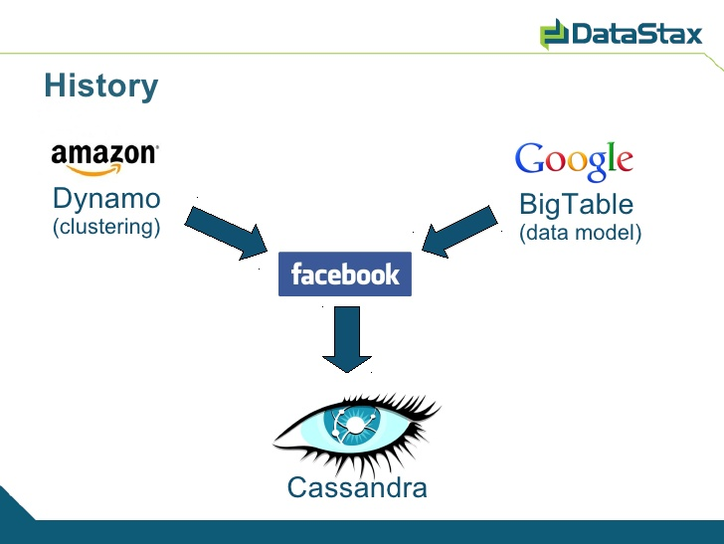
Cassandra Overview
http://www.slideshare.net/tylerhobbs/intro-to-cassandra

Slide 60
Cassandra Users (DataStax) http://www.datastax.com/wp-content/uploads/2012/10/WP-DataStax-WhyNoSQL.pdf?2

Slide 61
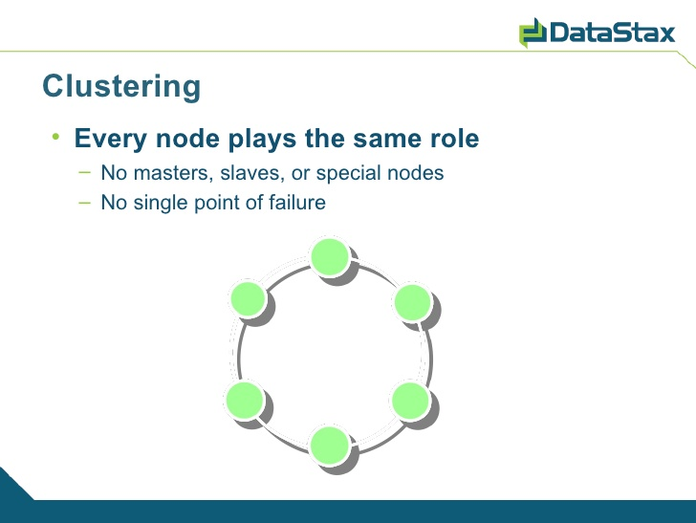
Cassandra Overview

Slide 62
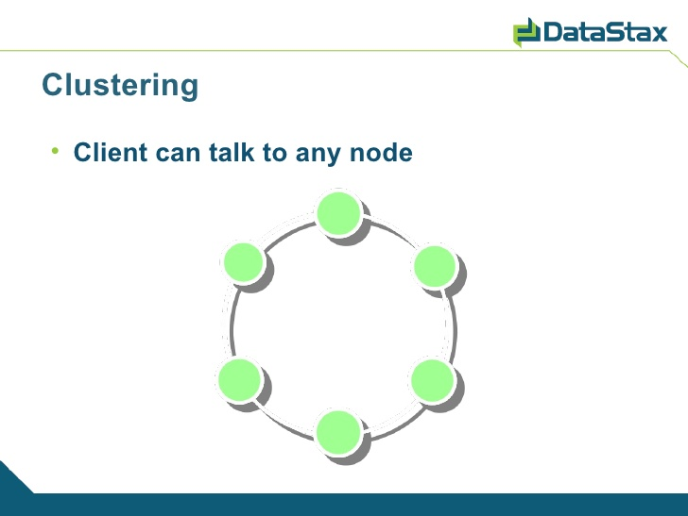
Cassandra Overview

Slide 63
Cassandra Overview Consistency
Let:
N = Total Number of Replicas
R = Replicas read before a response is returned
W = Replicas written to before a write is a success
Then:
W + R > N implies strong consistency
Intuition?
Example:
N=3; W=2; R=2; ➔ strong consistency

Slide 64
Cassandra Overview Tunable Consistency
Specify N per data set
Specify R and W per operation
Quorum: (N/2)+1
R + W = Quorum
Strong Consistency
Tolerate loss of (N – Quorum) replicas
R, W can also be 1 or N.

Slide 65
Cassandra Overview Clustering
No single point of failure
Scales linearly:
2x Nodes = 2x performance for both R and W
Distributed Replication

Slide 66
Cassandra Overview Column Families
Static
Object Data
Think: a relational dbms table
Dynamic
Pre calculated query results
Materialized Views.

Slide 67
Cassandra Overview Dynamic Column Families
Rows:
Each row has a unique key
Form a sorted list of name/value tuples
A name/value tuple is a “column”
Columns:
Each column has a timestamp
In case of collision, latest timestamp wins
Client specifies timestamp on write
Examples:
Timeline of Twitter Tweets by user
Timeline of tweets by all people followed
List of comments sorted by score.

Slide 68
Cassandra Overview Weaknesses
Transactions:
Not without a distributed lock
No guaranteed Atomicity, Isolation
Ad Hoc Queries
Oriented to scale

Slide 69
Searching
Relational
SELECT `column` FROM `database`,`table` WHERE `id` = key;
SELECT product_name FROM rockets WHERE id = 123;
Cassandra (standard)
keyspace.getSlice(key, “column_family”, "column")
keyspace.getSlice(123, new ColumnParent(“rockets”), getSlicePredicate());

Slide 70
Typical NoSQL API
Basic API access:
get(key) -- Extract the value given a key
put(key, value) -- Create or update the value given its key
delete(key) -- Remove the key and its associated value
execute(key, operation, parameters) -- Invoke an operation to the value (given its key) which is a special data structure (e.g. List, Set, Map .... etc).
Notes:
-> http://horicky.blogspot.com/2009/11/nosql-patterns.html

Slide 71
Cassandra CQL Example
SELECT name, occupation FROM users WHERE userid IN (199, 200, 207);
SELECT name AS user_name, occupation AS user_occupation FROM users;
SELECT time, value FROM events WHERE event_type = 'myEvent' AND time > '2011-02-03' AND time <= '2012-01-01'
SELECT COUNT(*) FROM users;
SELECT COUNT(*) AS user_count FROM users

Slide 72
Data Model
Within Cassandra, you will refer to data this way:
Column: smallest data element, a tuple with a name and a value
:Rockets, '1' might return:
{'name' => ‘Rocket-Powered Roller Skates',
‘toon' => ‘Ready Set Zoom',
‘inventoryQty' => ‘5‘,
‘productUrl’ => ‘rockets\1.gif’}
Notes:
-> Have heard it referred to as a 4 or 5 dimensional hash table.

Slide 73
Data Model Continued
ColumnFamily: There’s a single structure used to group both the Columns and SuperColumns. Called a ColumnFamily (think table), it has two types, Standard & Super.
Column families must be defined at startup
Key: the permanent name of the record
Keyspace: the outer-most level of organization. This is usually the name of the application. For example, ‘Acme' (think database name).
Notes:
-> Keys have different numbers of columns, so the database can scale in an irregular way.
-> Simple and Super: super columns are columns within columns.
-> Refer to date by keyspace, a column family, a key, an optional super column, and a column.

Slide 74
Cassandra and Consistency
Talked previous about eventual consistency
Cassandra has programmable read/writable consistency
One: Return from the first node that responds
Quorom: Query from all nodes and respond with the one that has latest timestamp once a majority of nodes responded
All: Query from all nodes and respond with the one that has latest timestamp once all nodes responded. An unresponsive node will fail the node
Notes:
-> http://www.slideshare.net/julesbravo/cassandra-3125809
-> Have a good simple benchmark to show to demonstrate difference between Cassandra and MySQL

Slide 75
Cassandra and Consistency
Zero: Ensure nothing. Asynchronous write done in background
Any: Ensure that the write is written to at least 1 node
One: Ensure that the write is written to at least 1 node’s commit log and memory table before receipt to client
Quorom: Ensure that the write goes to node/2 + 1
All: Ensure that writes go to all nodes. An unresponsive node would fail the write

Slide 76
Consistent Hashing
Partition using consistent hashing
Keys hash to a point on a fixed circular space
Ring is partitioned into a set of ordered slots and servers and keys hashed over these slots
Nodes take positions on the circle.
A, B, and D exists.
B responsible for AB range.
D responsible for BD range.
A responsible for DA range.
C joins.
B, D split ranges.
C gets BC from D.
Notes:
-> http://senguptas.org/Documents/cassandra_cs349c_presentation.pdf

Slide 77
Cassandra Installation & Examples
BIA 678

Slide 78
Outline
Terms
Windows Installation
Simple Examples
MIT_IP Data Example
What is Different?
Mac Installation

Slide 79
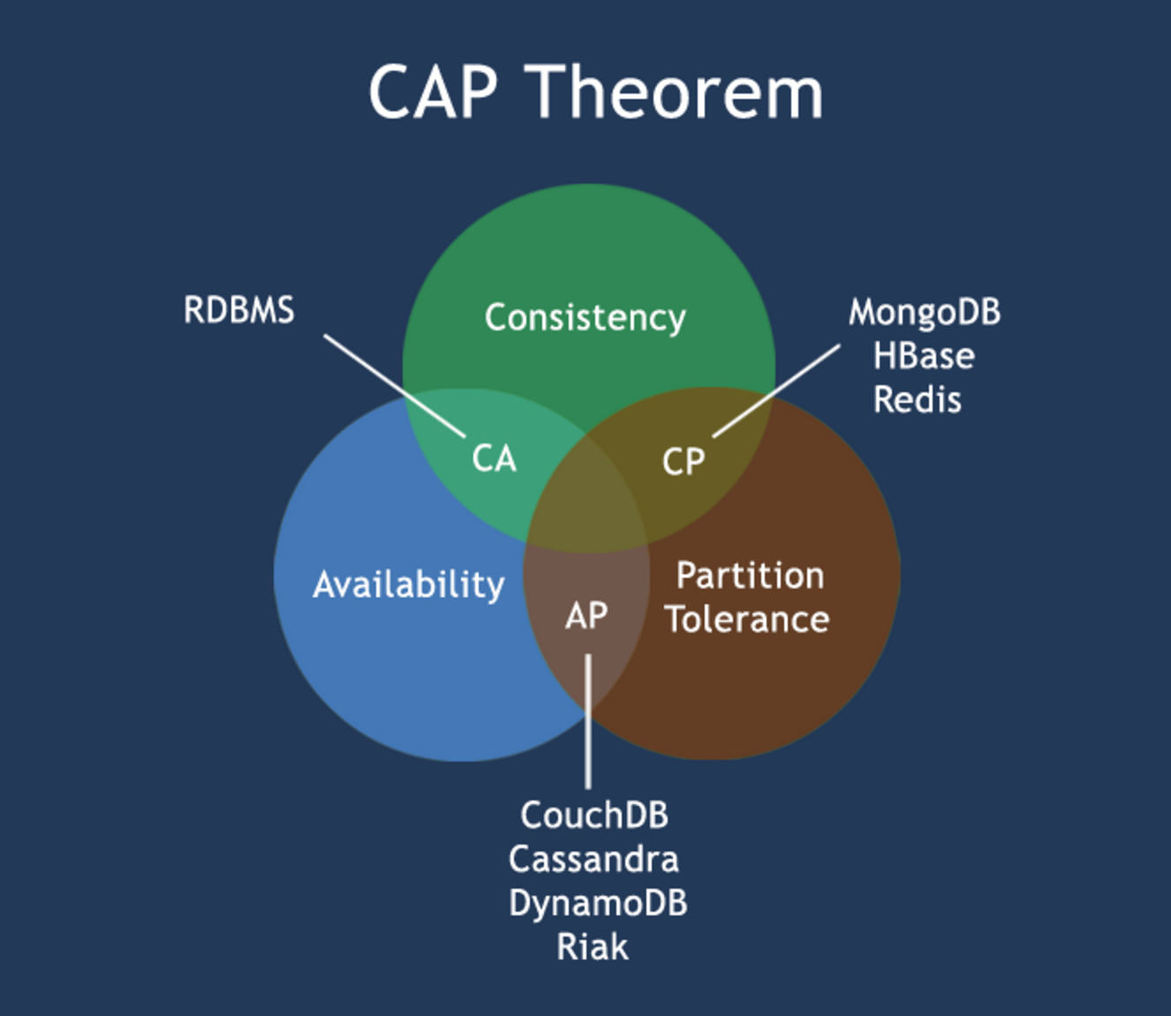
I. Terms
CAP tradeoff:
it is impossible for a distributed computer system to simultaneously provide all three of the following guarantees"
Consistency all nodes see the same data at the same time
Availability a guarantee that every request receives a response about whether it succeeded or failed
Partition tolerance the system continues to operate despite arbitrary partitioning due to network failures

Slide 80
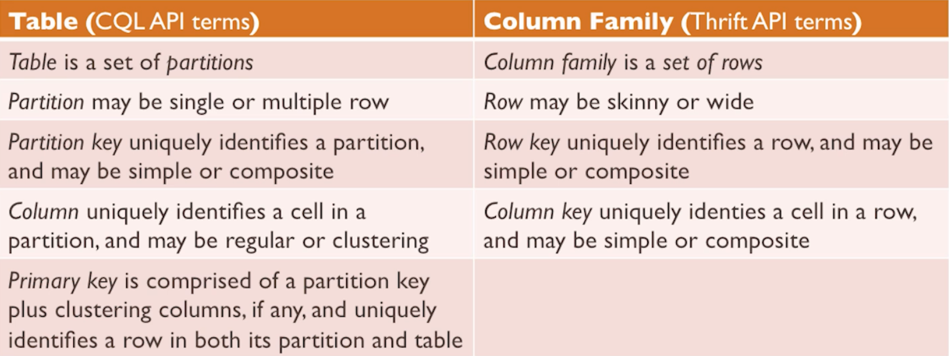
I. Terms
Theses terms are same.
Table (Cassandra 1.2+) = Column Family (before Cassandra 1.2)
https://academy.datastax.com/courses/ds201-cassandra-core-concepts, DS201 Course Slides, Artem Chebotko, Leo Schuman, Introducing Cassandra Data Model and Cassandra Query Language, April 8, 2014

Slide 81
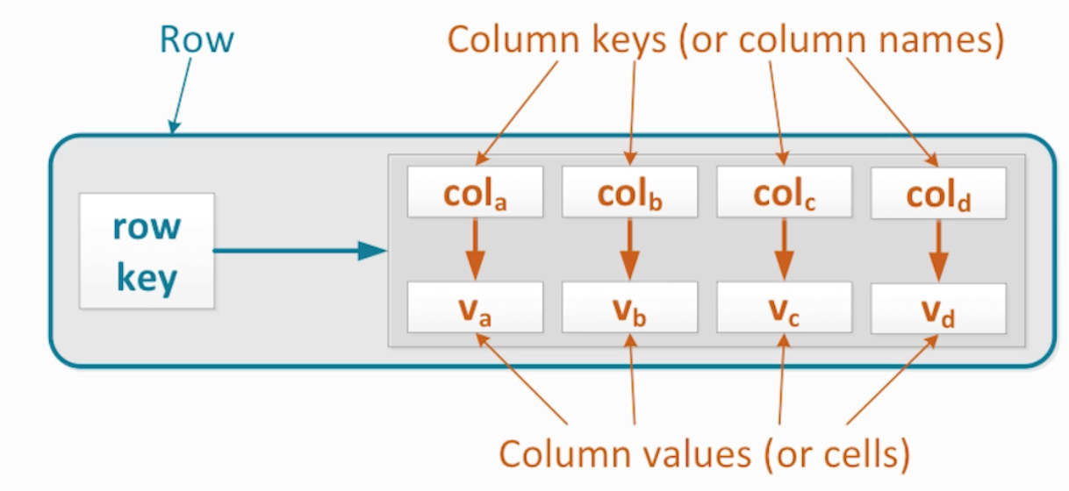
I. Terms
Row is the smallest unit that stores related data in Cassandra
Rows – individual rows constitute a column family
Row key – uniquely identifies a row in a column family
Row – store pair of column keys and column values
Column key – uniquely identifies a column value in a row
Column Value – stores one value or a collection of values
https://academy.datastax.com/courses/ds201-cassandra-core-concepts, DS201 Course Slides, Artem Chebotko, Leo Schuman, Introducing Cassandra Data Model and Cassandra Query Language, April 8, 2014

Slide 82
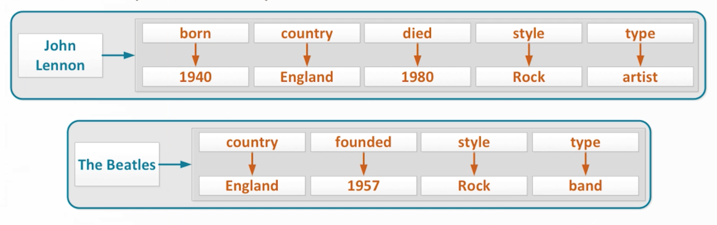
I. Terms
Sample Rows that describe an artist and a band in a same keyspace:
https://academy.datastax.com/courses/ds201-cassandra-core-concepts, DS201 Course Slides, Artem Chebotko, Leo Schuman, Introducing Cassandra Data Model and Cassandra Query Language, April 8, 2014

Slide 83
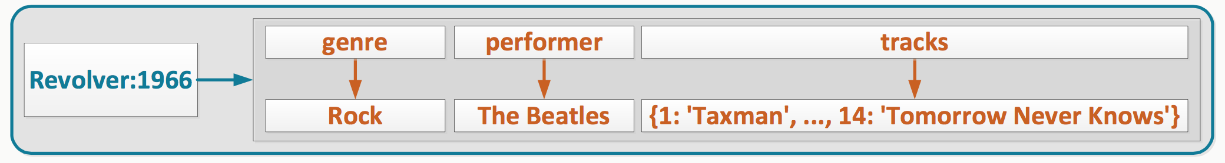
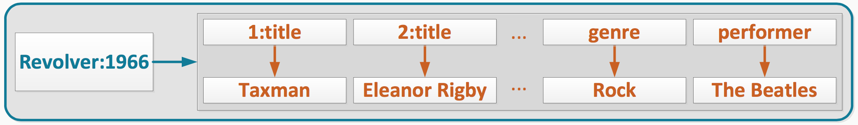
I. Terms
Composite row key – multiple components separated by colon
Composite column key – multiple components separated by colon
https://academy.datastax.com/courses/ds201-cassandra-core-concepts, DS201 Course Slides, Artem Chebotko, Leo Schuman, Introducing Cassandra Data Model and Cassandra Query Language, April 8, 2014

Slide 84
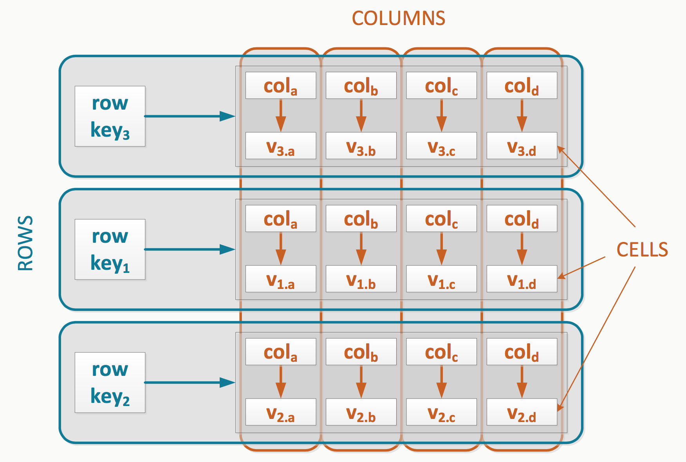
I. Terms
Column family – set of rows with a similar structure
https://academy.datastax.com/courses/ds201-cassandra-core-concepts, DS201 Course Slides, Artem Chebotko, Leo Schuman, Introducing Cassandra Data Model and Cassandra Query Language, April 8, 2014

Slide 85
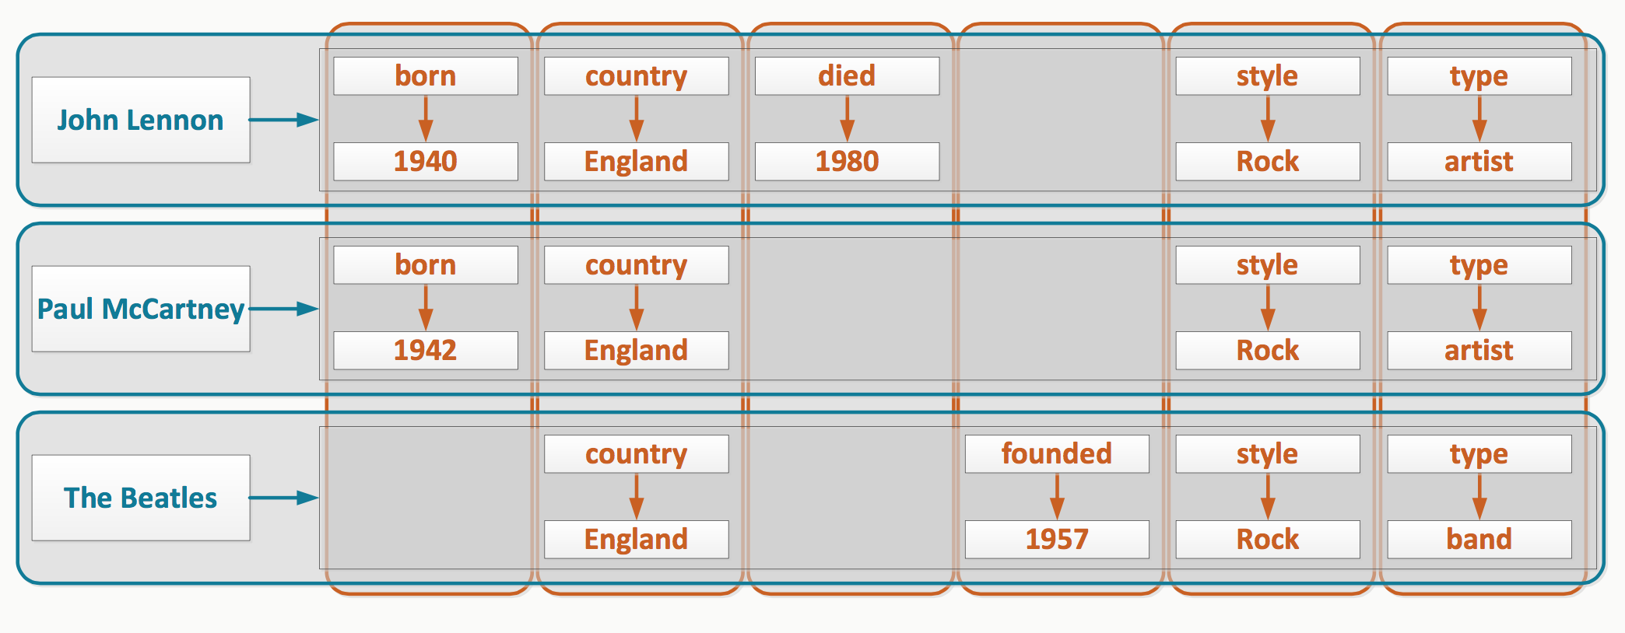
I. Terms
Distributed
Sparse
https://academy.datastax.com/courses/ds201-cassandra-core-concepts, DS201 Course Slides, Artem Chebotko, Leo Schuman, Introducing Cassandra Data Model and Cassandra Query Language, April 8, 2014

Slide 86
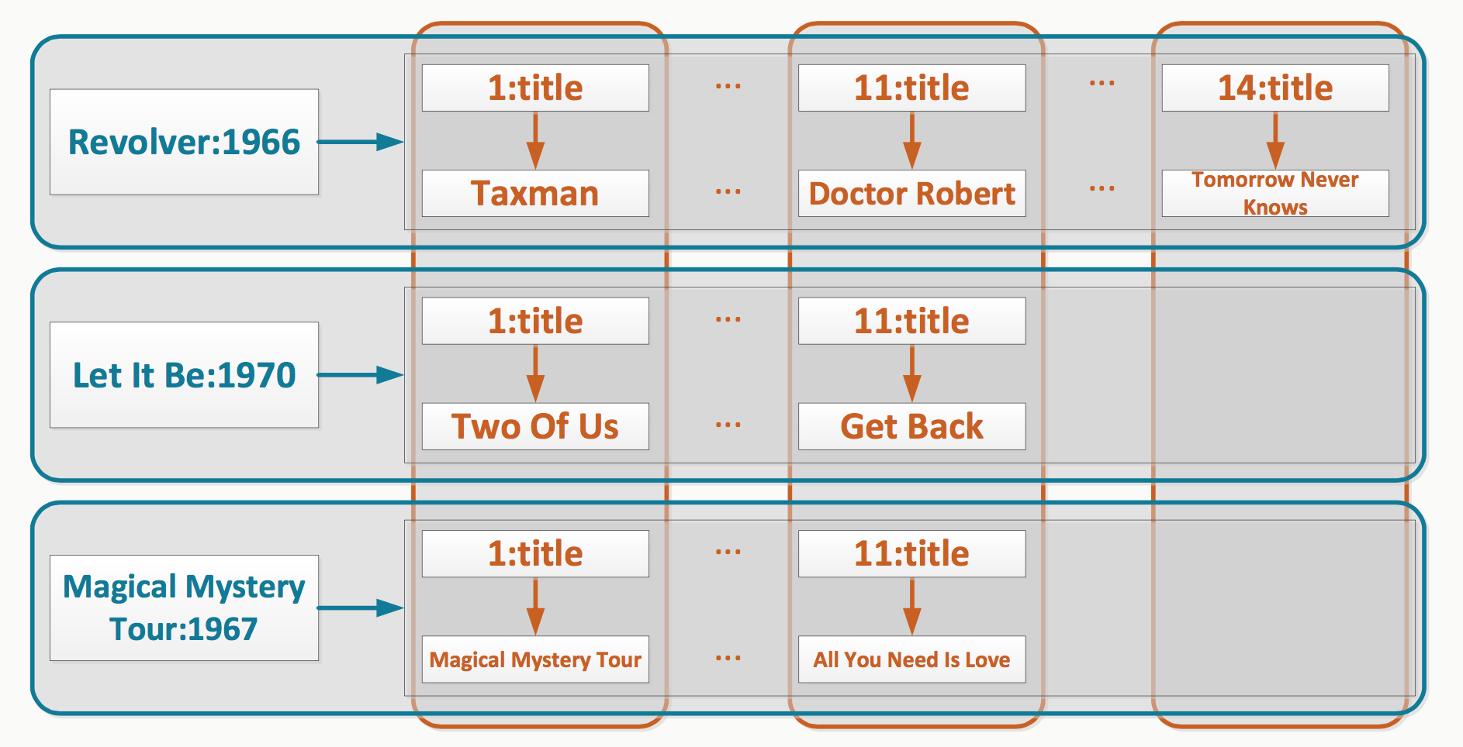
I. Terms
3. Sorted columns
4. Multidimensional(Column family that stores albums and their tracks)
https://academy.datastax.com/courses/ds201-cassandra-core-concepts, DS201 Course Slides, Artem Chebotko, Leo Schuman, Introducing Cassandra Data Model and Cassandra Query Language, April 8, 2014

Slide 87
I. Terms
Column family component size considerations
1. Data from a one row must fit on one node
Data from any given row never spans multiple nodes
2. Maximum columns per row is 2 billion
In practice – Up to 100 thousand
3. Maximum data size per cell (column value) is 2 GB
In practice – Up to 100 MB

Slide 88
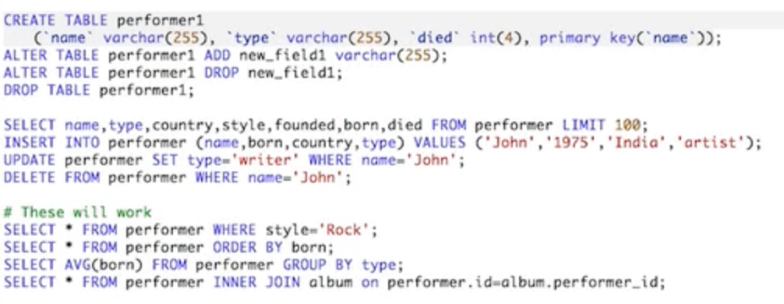
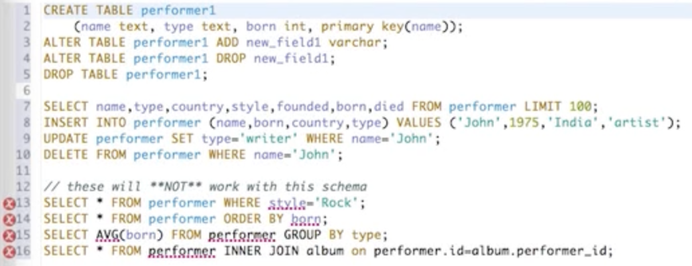
II. What is Different?
For this particular schema:
style is not in the primary keys
born is not in the primary keys
there is no 'average' aggregate function, and there is no 'group by' statement
no 'join' in Cassandra (doesn't mean we can't model relationships between entities)
SQL
CQL
https://academy.datastax.com/courses/ds201-cassandra-core-concepts, DS201

Slide 89
III. Mac Installation
1. Check your Java version in the terminal:
Java -version
If it's not 1.8, update it:
http://www.oracle.com/technetwork/java/javase/downloads/jdk8-downloads-2133151.html
2. Download Cassandra:
http://www.apache.org/dyn/closer.lua/cassandra/2.2.4/apache-cassandra-2.2.4-bin.tar.gz

Slide 90
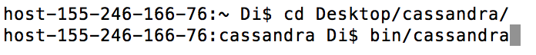
III. Mac Installation
3. Unzip (Double-click) the file. In my case, it is on the Desktop and is renamed as 'cassandra'.
4. Open the Terminal and go to that directory. Then open the Cassandra service. In my case, it's:
cd Desktop/cassandra/
bin/cassandra

Slide 91
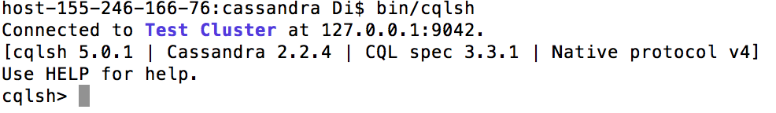
III. Mac Installation
5.Then, open a new terminal window:
cd Desktop/cassandra
bin/cqlsh
You should get:

Slide 92
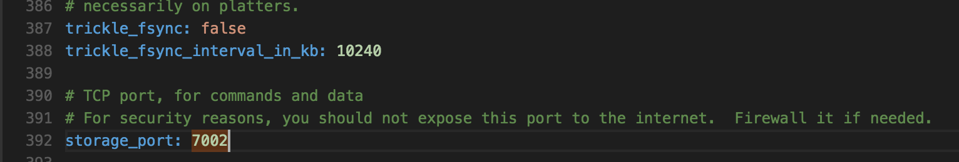
III. Mac Installation
6. If you can't get into the cql shell, try this code in the 'cassandra directory':
cd conf/
open cassandra.yaml
Search for the key word '7000', and change it to '7002':
Re-do the steps 4 – 5.

Slide 93
IV. Windows Installation
1. Update your java to 1.8
http://www.oracle.com/technetwork/java/javase/downloads/jdk8-downloads-2133151.html
2. Download Cassandra:
http://www.apache.org/dyn/closer.lua/cassandra/2.2.4/apache-cassandra-2.2.4-bin.tar.gz

Slide 94
IV. Windows Installation
3. Unzip (Double-click) the file. In my case, it is on the Desktop and is renamed as 'cassandra'.
4. Find the control panel (on windows 8 search for it).
Go to "system and security" and then "system".
Click on "Advanced Settings" and then the "Environment Variables" button.
Click on the new button an in the Variable name box type
JAVA_HOME under the value you'll need to put in the path to the java you are using. Mine is
C:\Program Files\java\jre1.8.0_71

Slide 95
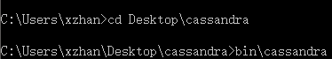
IV. Windows Installation
5. Search for 'cmd', and open the Command Prompt
Go to 'cassandra' directory, and then, run cassandra:
cd Desktop\cassandra
bin\cassandra

Slide 96
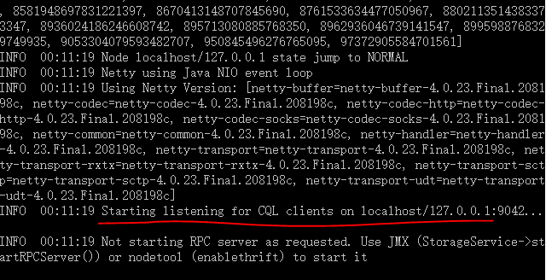
IV. Windows Installation
You should get logs like this:

Slide 97
IV. Windows Installation
Be sure you can see 'Start listening for CQL...'. Otherwise, try the following step:
open the 'cassandra.yaml' file in the 'conf' directory
Search for the key word '7000', and change it to '7002':
Re-do the steps 4 – 5.

Slide 98
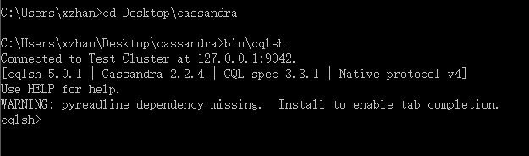
IV. Windows Installation
5.Then, open a new command prompt:
cd Desktop\cassandra
bin\cqlsh
You should get:

Slide 99
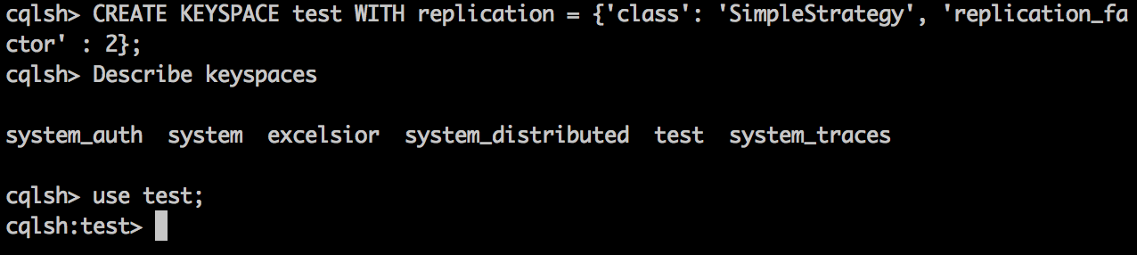
V. Simple Examples
1. Create Keyspace 'test':
CREATE KEYSPACE test WITH replication = {'class': 'SimpleStrategy', 'replication_factor' : 2};
2. Show Keyspaces:
DESC keyspaces;
3. Use Keyspace 'test':
USE test;

Slide 100
V. Simple Examples
4. Create column family ' Students':
CREATE TABLE Students (id int PRIMARY KEY, name text, grade float) WITH comment='Important BIA 678 records' AND read_repair_chance = 1.0;
5. Insert records:
INSERT INTO Students(id, name, grade) VALUES (1, 'Tom', 4.5);
INSERT INTO Students(id, name, grade) VALUES (2, 'Jerry', 4.0);
INSERT INTO Students(id, name, grade) VALUES (3, 'Nick', 5.0);
INSERT INTO Students(id, name, grade) VALUES (4, 'Jack', 4.0);

Slide 101
V. Simple Examples
6. Simple selection:
SELECT * from Students;
SELECT * from Students where grade>4;
The second query doesn't work. Following next step will enable the 'where' clause.
7. Create another table, and let grade be another primary key:
CREATE TABLE Students_true (id int, name text, grade float, PRIMARY KEY(id, grade)) WITH comment='New important BIA 678 records' AND read_repair_chance = 1.0;

Slide 102
V. Simple Examples
Insert the same records:
INSERT INTO Students_true(id, name, grade) VALUES (1, 'Tom', 4.5);
INSERT INTO Students_true(id, name, grade) VALUES (2, 'Jerry', 4.0);
INSERT INTO Students_true(id, name, grade) VALUES (3, 'Nick', 5.0);
INSERT INTO Students_true(id, name, grade) VALUES (4, 'Jack', 4.0);
Query again:
SELECT * from students_true where grade > 4 ALLOW FILTERING ;

Slide 103
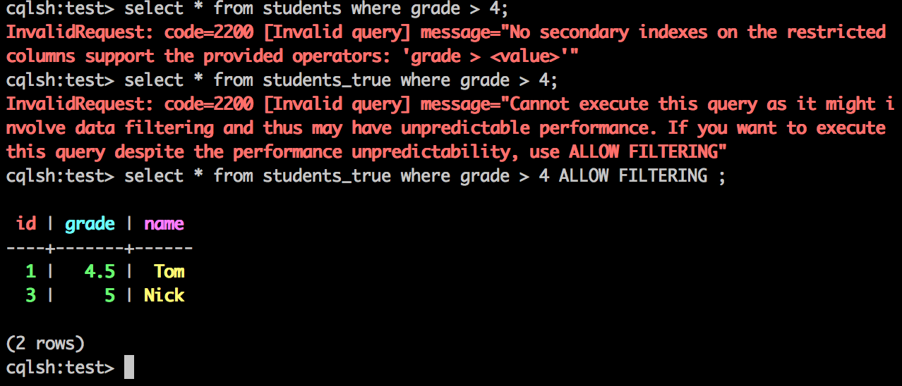
V. Simple Examples
When you attempt a potentially expensive query, such as searching a range of rows, 'allow filtering' clause is needed (be careful of this on a cluster).
Here is the the official guide, play with it!
https://cassandra.apache.org/doc/cql3/CQL-2.2.html

Slide 104
VI. MIT_IP Data Example
Example: Find the top 10 total_payload_size keys without attacking.
1. Download the mit_ip data (342.8MB) from:
https://drive.google.com/file/d/0Bw-mg84Th2OVR2d4eGx0T2hvWjg/view?usp=sharing
In Cassandra, you should design your data model to suit your queries.

Slide 105
VI. MIT_IP Data Example
2. Create a keyspace and a column family:
CREATE KEYSPACE mit_ip WITH replication = {'class': 'SimpleStrategy', 'replication_factor' : 1};
USE mit_ip;
Create table ip_data (key int, Protocol text, IP1 text, IP2 text, Port1 text, Port2 text, Num_of_Packets int, Beginning_time text, Ending_time text, Sent_packets_size int, Received_packets_size int, Total_packets_size int, Sent_payload_size int, Received_payload_size int, Total_payload_size int, Attack text, Direction text, PRIMARY KEY(Attack, Total_payload_size)) WITH comment='mit_ip_data' AND read_repair_chance = 1.0;

Slide 106
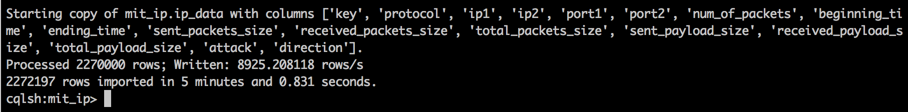
VI. MIT_IP Data Examples
3. Import the csv file into Cassandra:
Copy ip_data (key, Protocol, IP1, IP2, Port1, Port2, Num_of_Packets, Beginning_time, Ending_time, Sent_packets_size, Received_packets_size, Total_packets_size, Sent_payload_size, Received_payload_size, Total_payload_size, Attack, Direction) from '/Users/Di/Desktop/FinalSession.csv' with header=true;

Slide 107
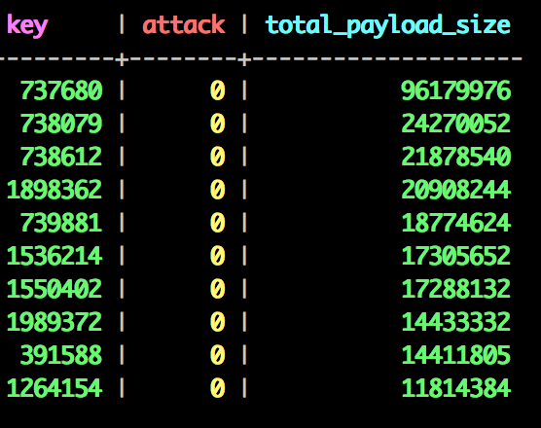
VI. MIT_IP Data Examples
4. Write query
select key, attack, total_payload_size from ip_data where attack = '0' ORDER BY total_payload_size DESC limit 10;
or to select all the columns in the column family:
select * from ip_data where attack = '0' ORDER BY
total_payload_size DESC limit 10;

Slide 108
Reference
Artem Chebotko, Leo Schuman, Introducing Cassandra Data Model and Cassandra Query Language, April 8, 2014

Slide 110
MongoDB http://docs.mongodb.org/manual/
“Focus on critical capabilities of Relational DBMS with innovations of NoSQL technologies.”
From RDBMS:
Expressive Query Language
Secondary Indexes
Strong Consistancy
From NoSQL Technology:
Flexible Data Model
Elastic Scalability
High Performance – Throughput and Latency

Slide 111
MongoDB Innovations
Fast, Iterative Development
Flexible Data Model
Multi-Datacenter Scalability
Integrated Feature Set
Lower TCO
Long Term Commitment

Slide 112
MongoDB

Slide 113
MongoDB vs RDBMS

Slide 114
MongoDB Query Model
Language Support:
Java, .NET, Ruby, PHP, JavaScript, Python, Perl node.js, Scala, …
Implemented as Methods within the API language.
Mongo Shell
Query Types:
Key-value queries
Range queries
Geospatial queries
Text Search
Aggregation Framework
MapReduce queries - JavaScript

Slide 115
MongoDB Querys http://docs.mongodb.org/manual/reference/sql-comparison/
SQL Terms/Concepts | MongoDB Terms/Concepts
database | database
table | collection
row | document or BSON document
column | field
index | index
table joins | embedded documents and linking
primary key Specify any unique column or column combination as primary key. | primary key In MongoDB, the primary key is automatically set to the _id field.
aggregation (e.g. group by) | aggregation pipeline See the SQL to Aggregation Mapping Chart.

Slide 116
MongoDB Aggregate Querys http://docs.mongodb.org/manual/reference/sql-aggregation-comparison/
SQL Terms, Functions, and Concepts | MongoDB Aggregation Operators
WHERE | $match
GROUP BY | $group
HAVING | $match
SELECT | $project
ORDER BY | $sort
LIMIT | $limit
SUM() | $sum
COUNT() | $sum
join | No direct corresponding operator; however, the $unwindoperator allows for somewhat similar functionality, but with fields embedded within the document.

Slide 117
MongoDB Querys
SQL Example | MongoDB Example | Description
SELECT COUNT(*) AS count FROM orders | db.orders.aggregate( [ { $group: { _id: null, count: { $sum: 1 } } } ] ) | Count all records fromorders
SELECT SUM(price) AS total FROM orders | db.orders.aggregate( [ { $group: { _id: null, total: { $sum: "$price" } } } ] ) | Sum theprice field from orders

Slide 118
MongoDB Querys
SQL Example | MongoDB Example | Description
SELECT COUNT(*) AS count FROM orders | db.orders.aggregate( [ { $group: { _id: null, count: { $sum: 1 } } } ] ) | Count all records fromorders
SELECT SUM(price) AS total FROM orders | db.orders.aggregate( [ { $group: { _id: null, total: { $sum: "$price" } } } ] ) | Sum theprice field from orders
SELECT cust_id, SUM(price) AS total FROM orders GROUP BY cust_id | db.orders.aggregate( [ { $group: { _id: "$cust_id", total: { $sum: "$price" } } } ] ) | For each uniquecust_id, sum theprice field.
SELECT cust_id, SUM(price) AS total FROM orders GROUP BY cust_id ORDER BY total | db.orders.aggregate( [ { $group: { _id: "$cust_id", total: { $sum: "$price" } } }, { $sort: { total: 1 } } ] ) | For each unique cust_id, sum the price field, results sorted by sum.

Slide 119
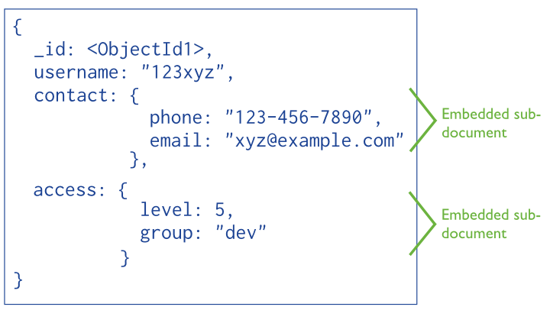
MongoDB Document - Denormalized

Slide 120
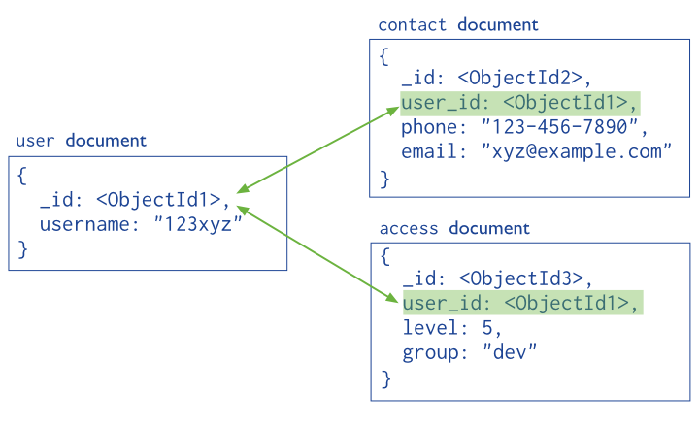
MongoDB Document - Normalized

Slide 121
MongoDB Indexing
Unique Indexes : Referential Integrity
Compound Indexes
Array Indexes
TTL (Time to Live) Indexes
Geospatial Indexes
Sparse Indexes
Text Search Indexes
+
Query Optimization

Slide 122
MongoDB Automatic Sharding
Range Based Sharding
Hash Based Sharding
Location Aware Sharding

Slide 123
MongoDB Security
Authentication – LDAP, Kerberos, …
Authorization – User defined roles
Auditing
Encryption – Network and Disk

Slide 124
MongoDB – Sharding and Replicas

Slide 125
MongoDB – Telefonica

Slide 126
MongoDB – Sharding and Replicas

